Slide 1

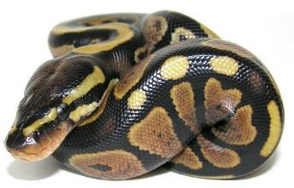
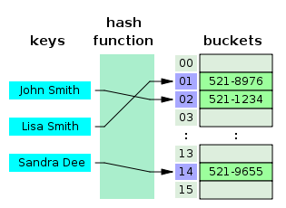
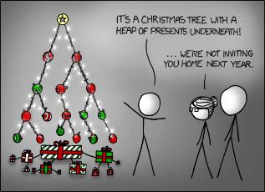
CHEME 5500 Software Carpentry
Python – A Crash Course
Data Structures

Slide 2
Why Data Structures?
Organization
Because we’re human, we conceptualize things better if they’re structured
Instead of having N variables, we can have one that holds N values
Speed
It can be MUCH faster to search (ex. smallest value) in a data structure
Math
Sometimes, it’s required by math! Ex. Matrices

Slide 3
Common Data Structures
Things we’ve already seen:
Strings
Lists and Tuples
New concepts to this class:
Dictionaries (Hash Tables)
Linked Lists
Binary Trees
Stacks and Queues

Slide 4
Dictionaries

Slide 5
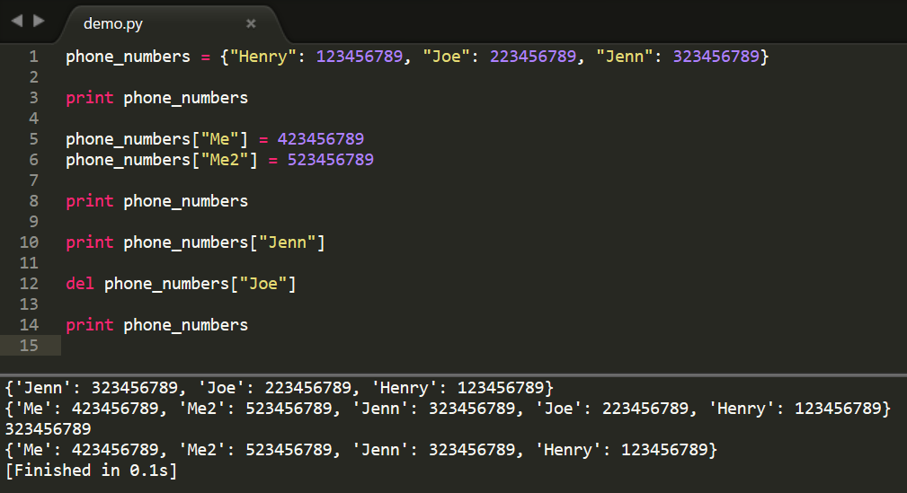
Dictionaries

Slide 6
Dictionaries
Denoted in Python using { }
Instead of indices by integers, as in lists, indices by strings, integers, floats, or even other objects (classes/structs/functions)
Add elements:
When being defined:
ex_dict = {“elem1”: 4}
Whenever:
ex_dict[“elem2”] = 5
Delete elements using del keyword:
del ex_dict[“elem2”]
Get all “keys” using “.keys()”

Slide 7
PRACTICE!
Make a dictionary with the keys as integers, and the corresponding values being the string of the integer
NOTE! Try making this within a loop!
Do this for integers 4 -> 343 (inclusive on both sides)

Slide 8
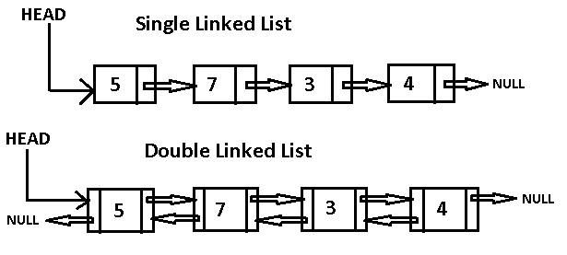
Linked Lists
A list of objects, with each element “pointing” to the next
A double linked list also points backwards
Not commonly used in python

Slide 9
Binary Trees
A form of data organization
Each element has a maximum of 2 children nodes
A binary tree can insert, delete, and traverse nodes.
Which is faster, finding max/min in an unorganized list, or a sorted binary tree:
5
3
12
1
4
7
23
6
Good Will Hunting Problem
Notes:
Heaps – Fancy tree in which Parents -> Child have some ordering.
Ex. Max Heap means the parent is always >= child
Min heap means the parent is always <= child

Slide 10
Balanced Binary Trees
5
5
3
3
12
1
1
4
7
23
4
6
6
7
23
12

Slide 11
Classes
Object Oriented:
A method of programming in which we focus on a modular approach, via objects
Consider the following: link
Classes allow for custom Objects!

Slide 12
